Slide 1
Performance Snapshot
Total Revenue:$67K +
Categories in inventory: 16
Inventory Size: 4.5k
Number of Stores: 2

Slide 2
Title Telegraph Voyage generated the highest revenue

Slide 3
74% Titles (743) earned less than $100

Slide 4
Title duration does not impact the revenue

Slide 5
Revenue By Ratting

Slide 6
Both stores generates same revenue with equal level of stock

Slide 7
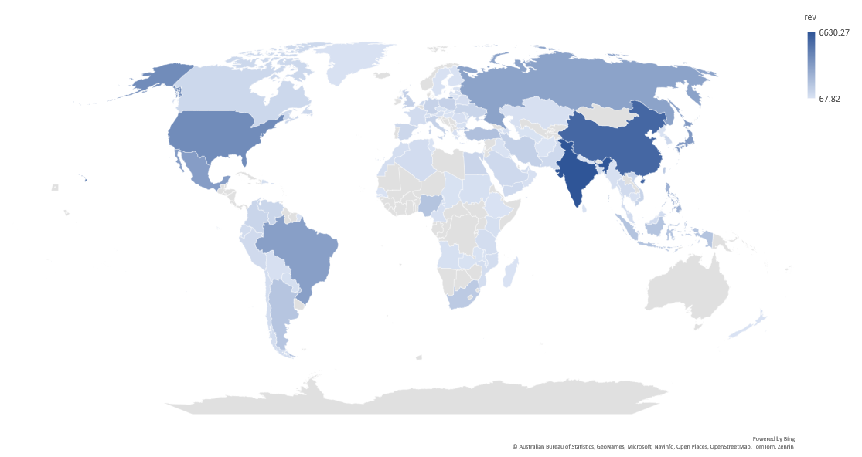
India & China contributed most to the Revenue

